Slide 1






Foundations of
Quantum Information Science (QIS 101)
Dave Biersach
Brookhaven National Laboratory
dbiersach@bnl.gov
Session 06
Data Visualization

Slide 2
Session 06 – Goals
Plot 2-D equations using the Python package matplotlib and its pyplot module
Relate the pyplot figure object to its axes object
Learn how to decorate plots with titles, labels, grids, etc.
Understand vectorized operations that implicitly operate on an entire NumPy array with just one algebraic expression
Use the SymPy package to do exact symbolic (analytic) calculus (limits, derivatives, integrals, etc.)
Plot parametric equations using polar graphs
Combine multiple plots into a single output window

Slide 3
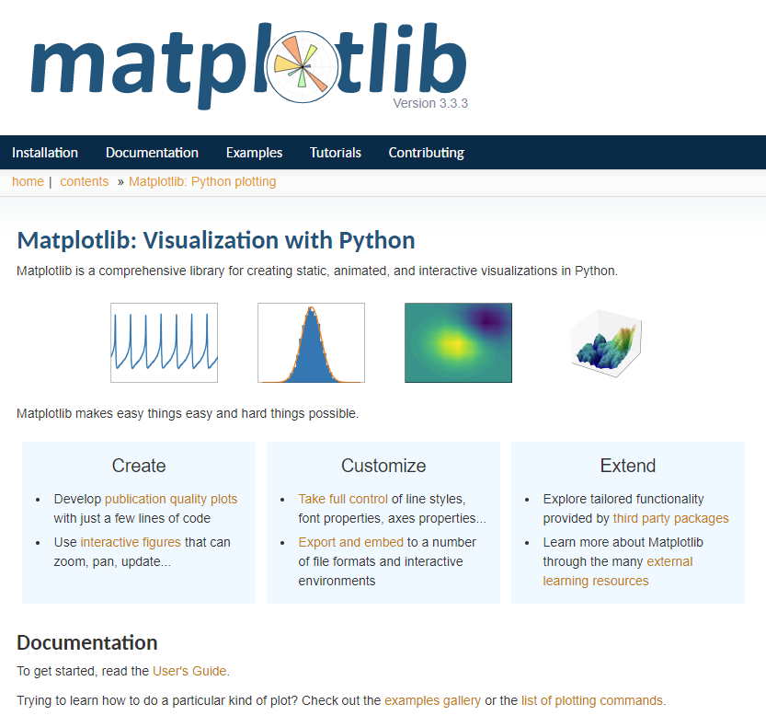
https://matplotlib.org

Slide 4

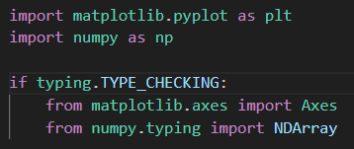
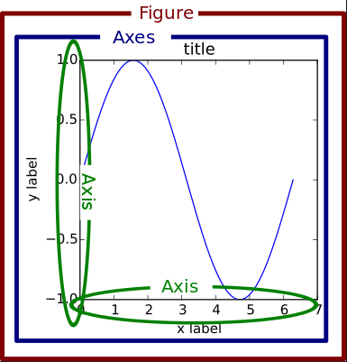
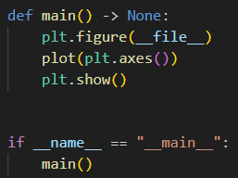
Open plot_parabola.py
https://matplotlib.org/stable/api/pyplot
①
https://numpy.org/doc/stable/reference
②
③
④
⑦
⑧
⑨
⑩
⑤
⑥

Slide 5
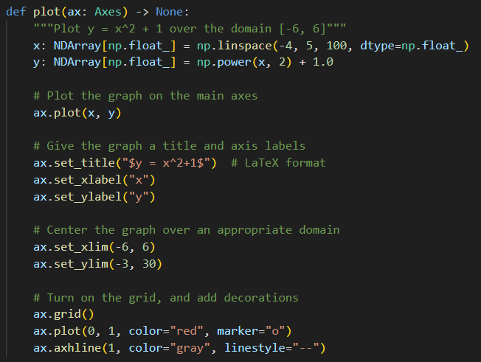
View plot_parabola.py
①
②
Vectorized Operations in NumPy
③
④
⑤
⑥
⑦
⑧
⑨
⑩

Slide 6
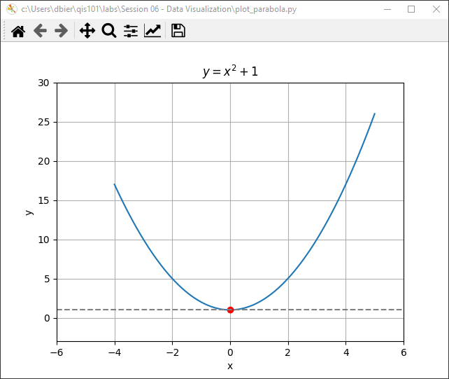
Run plot_parabola.py
①
You must close the plot window

Slide 7

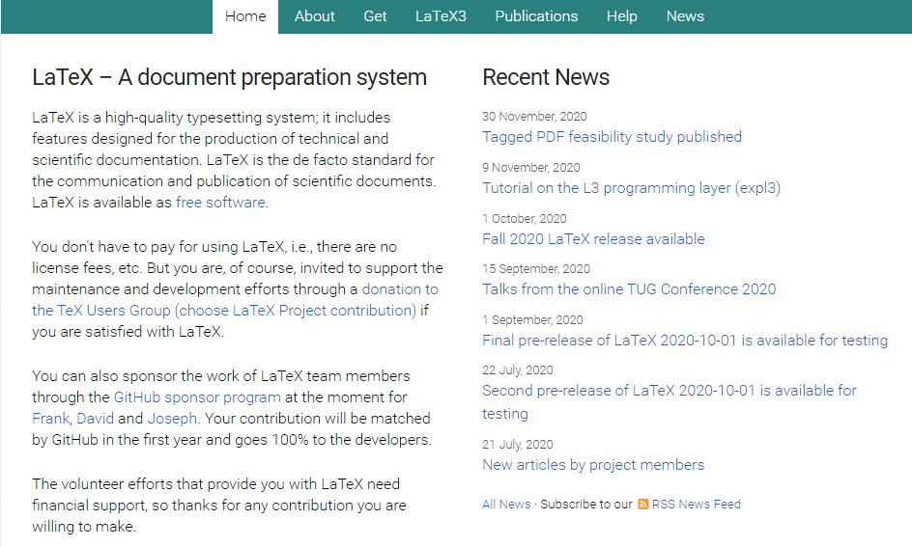
https://www.latex-project.org

Slide 8

https://www.overleaf.com

Slide 9

https://www.overleaf.com/learn/latex/Learn_LaTeX_in_30_minutes

Slide 10

https://www.texstudio.org
100% free – runs on Windows, Mac, Linux

Slide 11
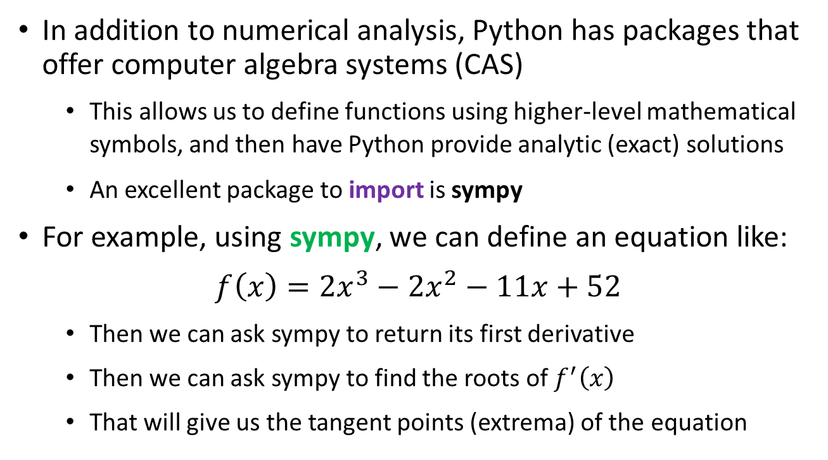
Symbolic Algebra & Calculus
In addition to numerical analysis, Python has packages that offer computer algebra systems (CAS)
This allows us to define functions using higher-level mathematical symbols, and then have Python provide analytic (exact) solutions
An excellent package to import is sympy
For example, using sympy, we can define an equation like:
$$f\left(x\right)=2x^{3}−2x^{2}−11x+52$$
Then we can ask sympy to return its first derivative
Then we can ask sympy to find the roots of $f^{′}\left(x\right)$
That will give us the tangent points (extrema) of the equation

Slide 12
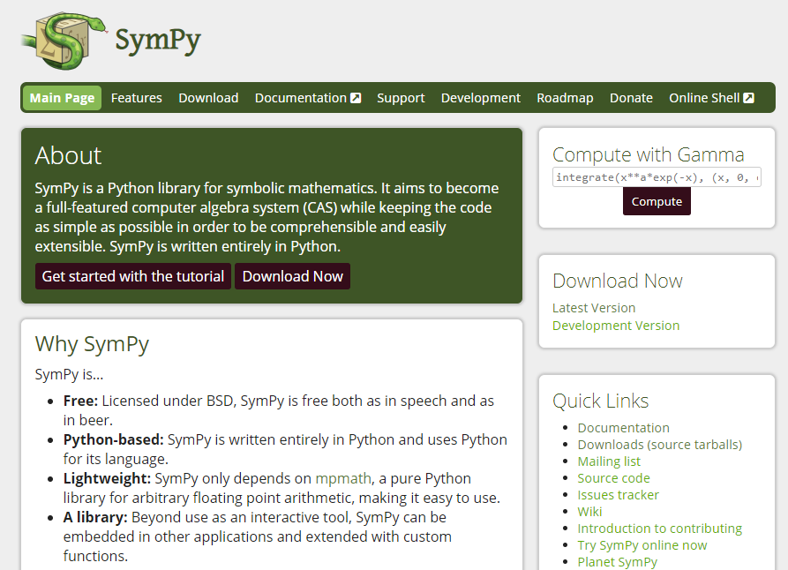
Symbolic Algebra & Calculus
https://www.sympy.org

Slide 13
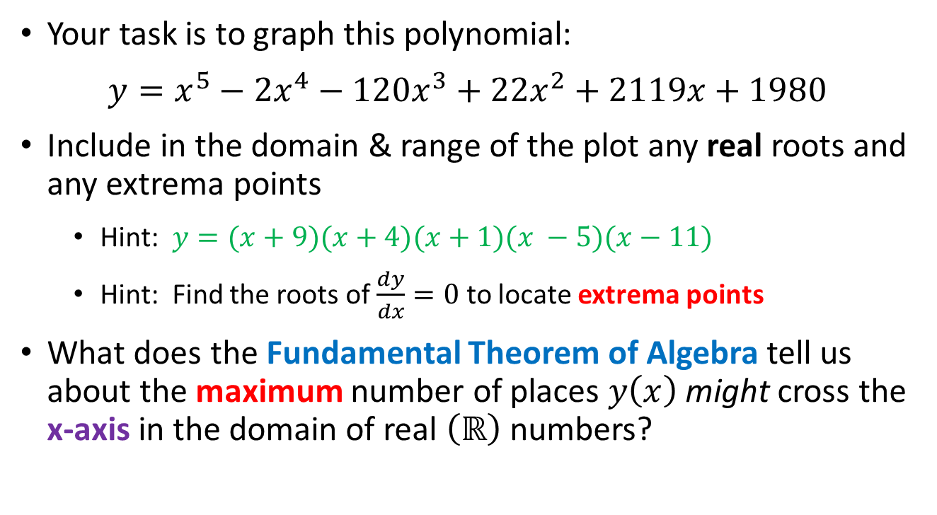
Symbolic Algebra & Calculus
Your task is to graph this polynomial:
$y=x^{5}−{2x}^{4}−120x^{3}+22x^{2}+2119x+1980$
Include in the domain & range of the plot any real roots and any extrema points
Hint: $y=(x+9)(x+4)(x+1)(x −5)(x−11)$
Hint: Find the roots of $\frac{dy}{dx}=0$ to locate extrema points
What does the Fundamental Theorem of Algebra tell us about the maximum number of places $y\left(x\right)$ might cross the x-axis in the domain of real $\left(ℝ\right)$ numbers?

Slide 14
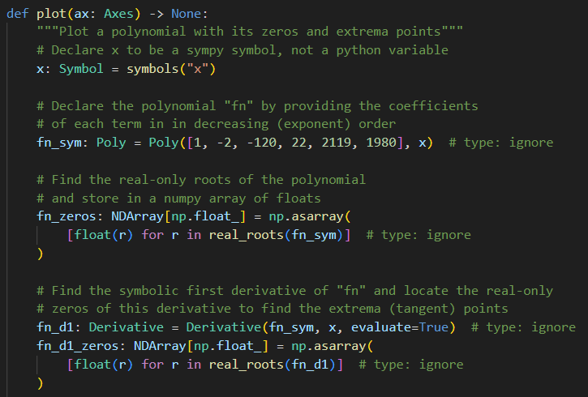
Open plot_polynomial.py
①
②
③
④
⑤
⑥
⑦
⑧

Slide 15
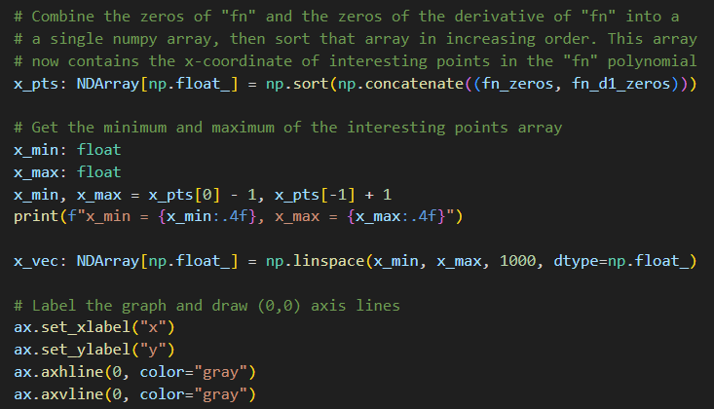
View plot_polynomial.py
①
②
③
④
⑤
⑥

Slide 16
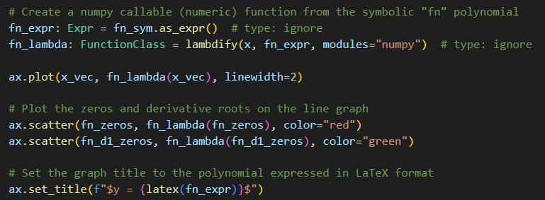
View plot_polynomial.py
①
②
③
④
⑤
⑥

Slide 17
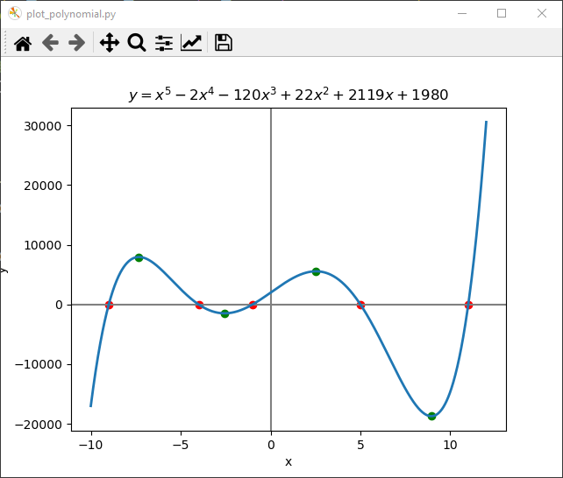
Run plot_polynomial.py
☺

Slide 18
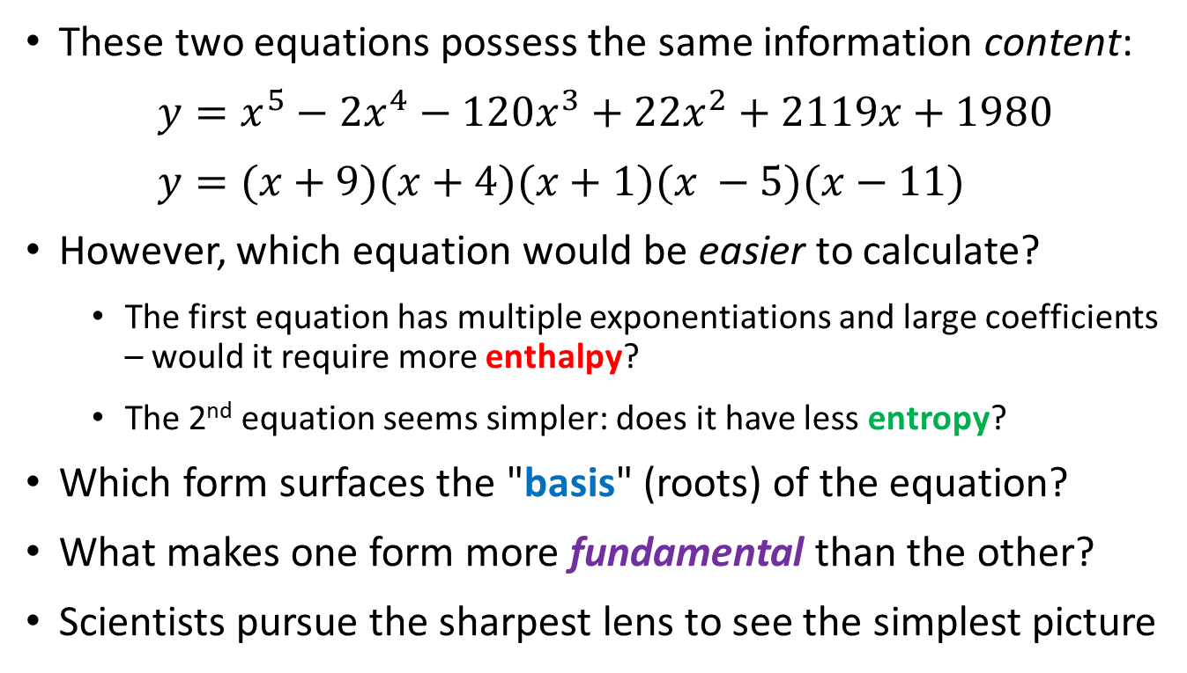
The Thermodynamics of Calculation
These two equations possess the same information content:
$y=x^{5}−{2x}^{4}−120x^{3}+22x^{2}+2119x+1980$
$$y=(x+9)(x+4)(x+1)(x −5)(x−11)$$
However, which equation would be easier to calculate?
The first equation has multiple exponentiations and large coefficients – would it require more enthalpy?
The 2nd equation seems simpler: does it have less entropy?
Which form surfaces the "basis" (roots) of the equation?
What makes one form more fundamental than the other?
Scientists pursue the sharpest lens to see the simplest picture

Slide 19
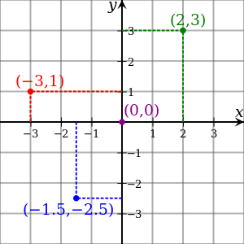
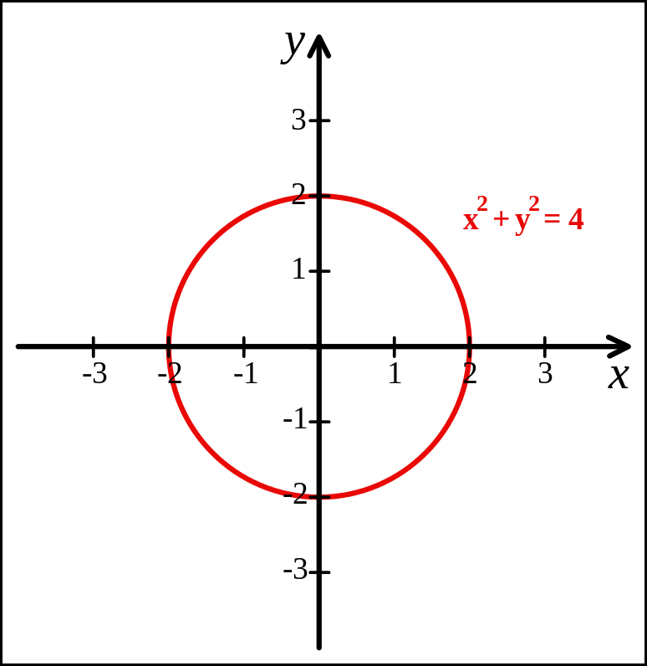
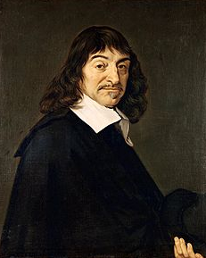
Cartesian Coordinates
Created by René Descartes in 1637

Slide 20
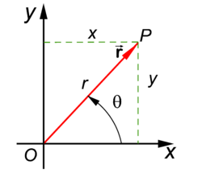
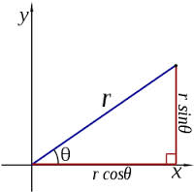
Polar Coordinates
A radius and an angle (theta)
make a 2D polar coordinate
$$(r∗\cos{θ, r ∗ \sin{θ)}}$$

Slide 21
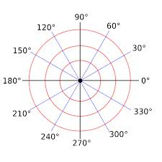
Polar Coordinates

Slide 22
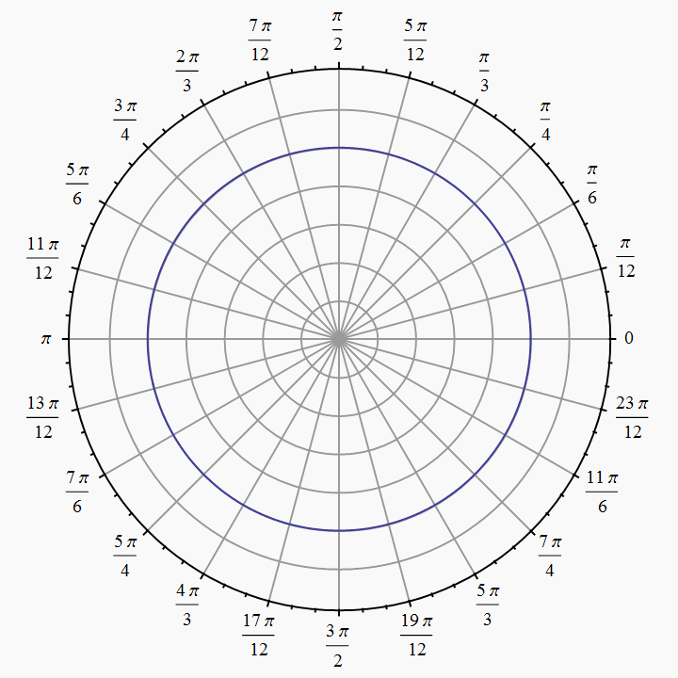
Polar Coordinates
Angles are measured in
radians
(0 ≤ θ ≤ $2π)$

Slide 23
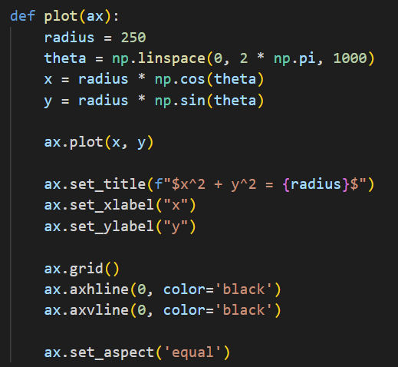
Open plot_circle.py
①
②
③
④
⑤
⑥
⑦
⑧
⑨

Slide 24
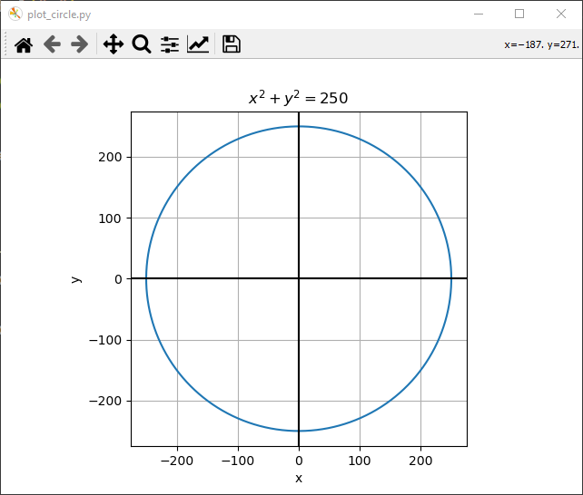
Run plot_circle.py
That looks like a circle!
☺

Slide 25
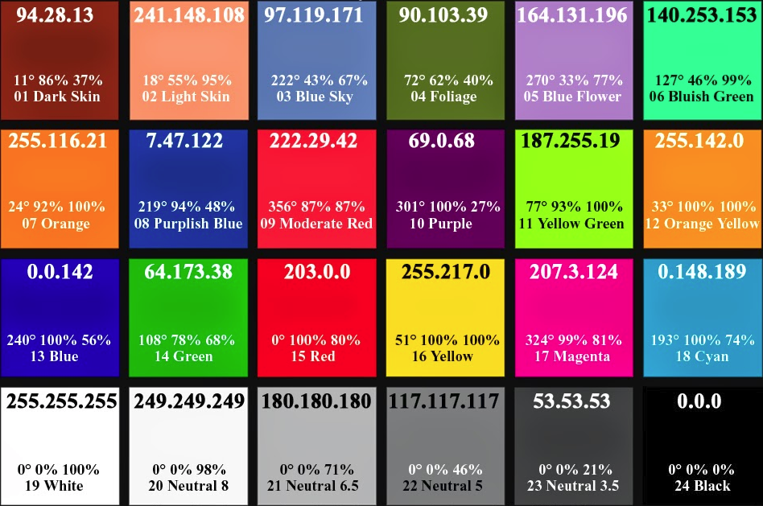
Various Colors in RGB Values

Slide 26
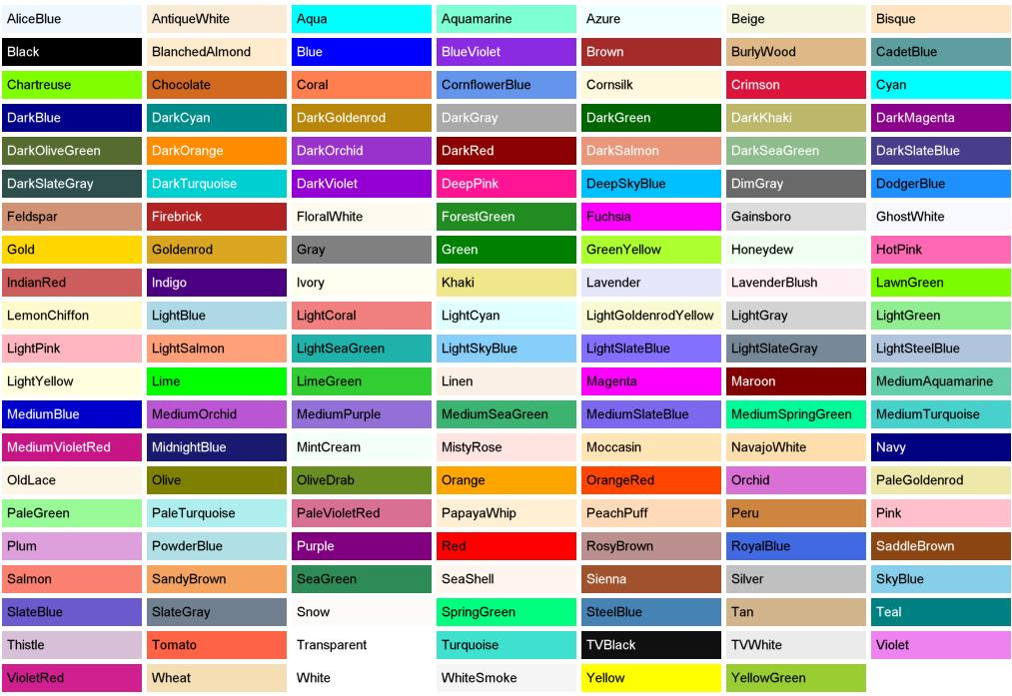
Predefined Color “Names”

Slide 27
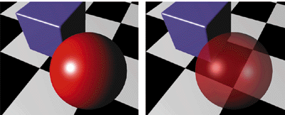
Alpha Blending = Opacity
Alpha = 0 means fully transparent (see through)
Alpha = 255 means fully opaque

Slide 28

Drawing the Olympic Rings
x_offset
(0,0)
y_offset
x_offset / 2

Slide 29
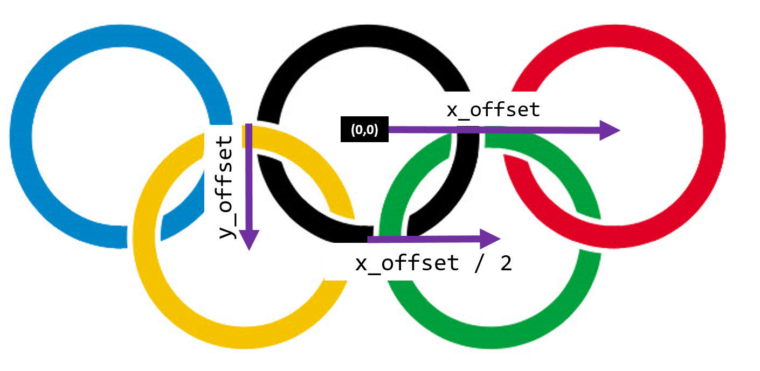
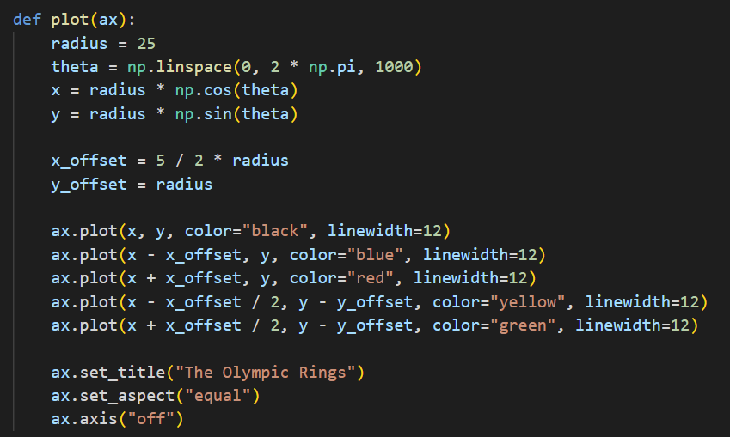
Open plot_rings.py
①
②
③
④
⑤

Slide 30

Run plot_rings.py
☺

Slide 31
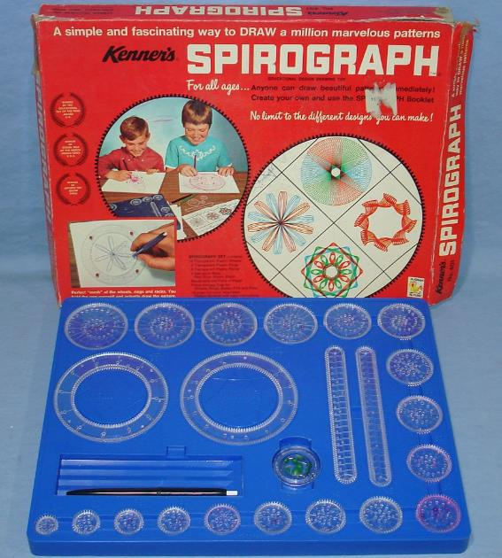
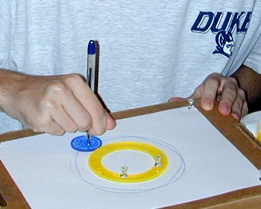
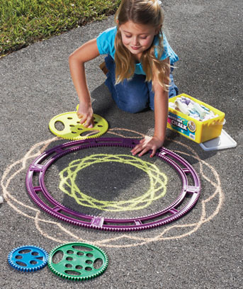

Parametric Curves

Slide 32
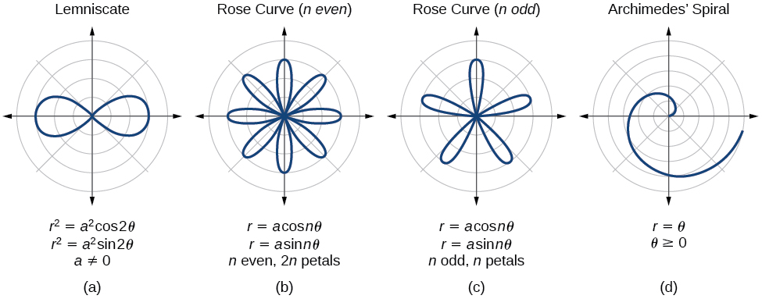
Parametric Curves
The two parameters a, n are used to calculate the current radius $r$ as $θ$sweeps the circle

Slide 33
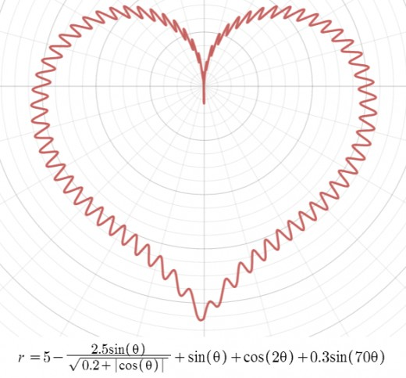
Parametric Curves

Slide 34
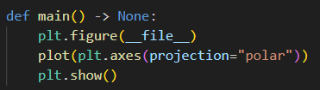
Open plot_rose_curves.py
①

Slide 35
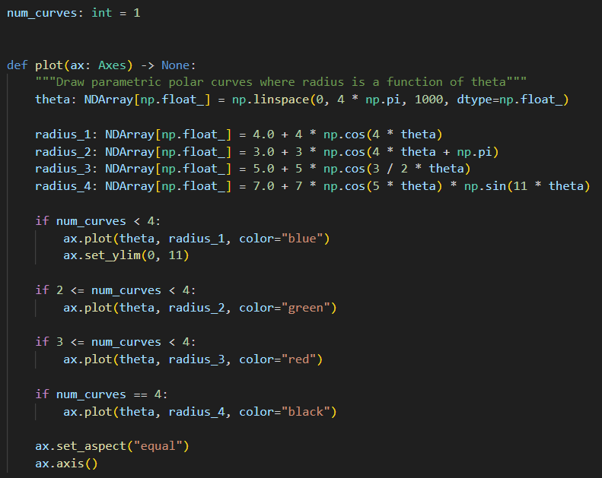
View plot_rose_curves.py
①
②
③
④
⑤
⑥
⑦
⑧
⑨
⑩

Slide 36
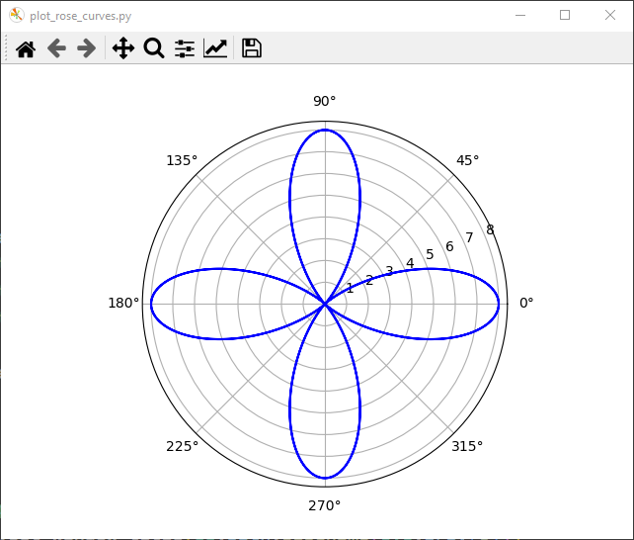
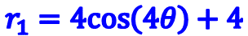
Run plot_rose_curves.py
Don't forget to close the plot window after each run!
$$r_{1}=4cos\left(4θ\right)+4$$

Slide 37
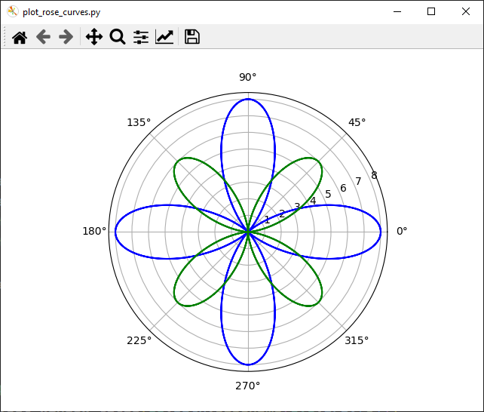
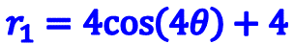
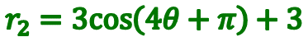
Set num_curves = 2
$$r_{1}=4cos\left(4θ\right)+4$$
$$r_{2}=3cos\left(4θ+π\right)+3$$

Slide 38
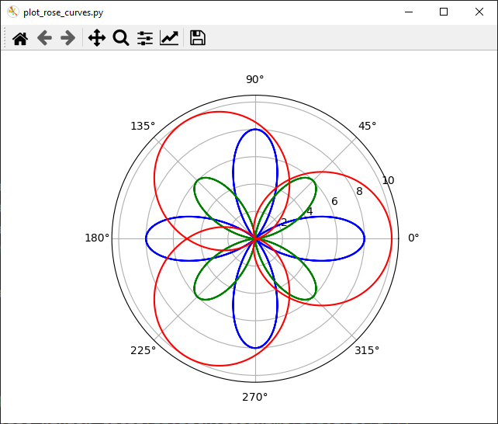
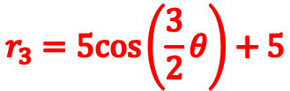
Set num_curves = 3
$$r_{1}=4cos\left(4θ\right)+4$$
$$r_{2}=3cos\left(4θ+π\right)+3$$
$$r_{3}=5cos\left(\frac{3}{2}θ\right)+5$$

Slide 39
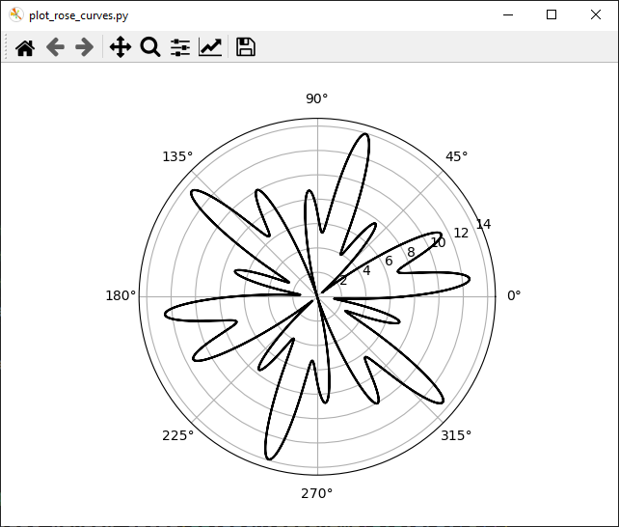
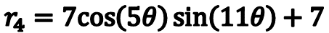
Set num_curves = 4
$$r_{4}=7cos\left(5θ\right)\sin\left(11θ\right)+7$$

Slide 40
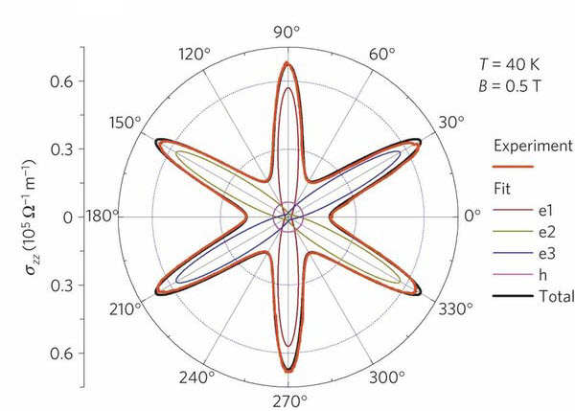
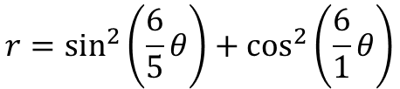
Parametric Curves
Field Induced Polarization of Dirac Valleys in Bismuth*
$$r=\sin^{2}\left(\frac{6}{5}θ\right)+\cos^{2}\left(\frac{6}{1}θ\right)$$
*Bismuth is the element with the highest atomic mass that is stable

Slide 41
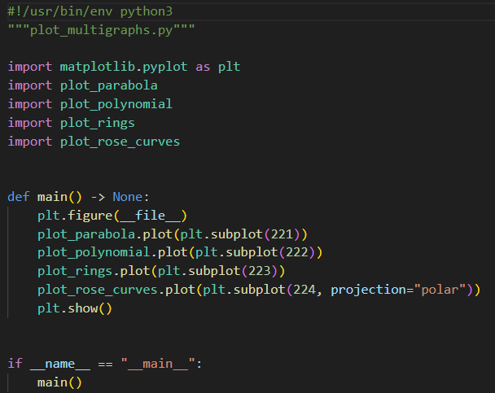
Open plot_multigraphs.py
①
matplotlib.pyplot.subplot
②
#rows #cols index#
③
④
⑤
⑥

Slide 42
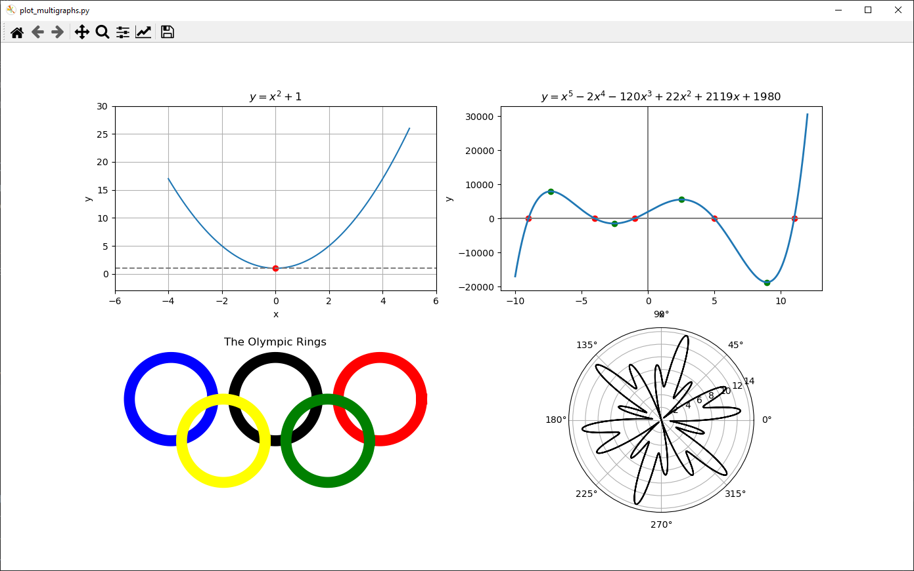
Run plot_multigraphs.py

Slide 43
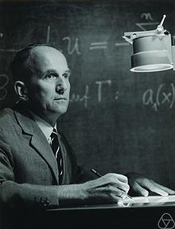
The Collatz Conjecture
First proposed in 1945 by Lothar Collatz, it remains unsolved
Take any positive integer n
If n is even, divide it by 2
If n is odd, multiply it by 3 and add 1
Repeat the process until n reaches 1
The conjecture is that no matter what integer you start with the process will always reach 1
It is maddening simple to state, but no one has been able to prove this claim is either true or false!
What is the sequence for 26 ?

Slide 44
The Collatz Conjecture
26
13
40
20
10
5
16
8
4
2
1
If n is even, divide it by 2
If n is odd, multiply it by 3 and add 1
Repeat the process until n reaches 1
What is the sequence for 26 ?
What is the sequence for 27 ?
26 took 10 steps to reach 1

Slide 45


The Collatz Conjecture
Step Value
Step Count

Slide 46

Stopping Time
The stopping time (for a given integer n) is the total number of Collatz iterations before reaching 1
This graph shows the stopping times for n < 10,000
Stopping times appear to exhibit a rough pattern, but we have no formula to accurately predict it for any n
Stopping Time
Increasing n

Slide 47

Frequency of Stopping Times
We are interested in analyzing the frequency (count) of each stopping time for n < 1,000,000
What is the overall shape of the distribution of stopping times?
We will use a histogram to display the count of each stopping time
Your task is to implement the stopping time function:

Slide 48

Open collatz_conjecture.py
①
②
③
④

Slide 49

View collatz_conjecture.py
④
⑤
⑥
⑦
①
②
③
⑧

Slide 50


Run collatz_conjecture.py
This can take up to 30 secs
Would you have guessed the stopping time distribution takes this shape?

Slide 51

Random Walks
Your scientist/mentor/PI wants you to create a Python program to display a 2D Cartesian plot of a meandering path
The walker starts at the (0,0) origin and takes one step at a time
At each step, the walker picks a random angle (uniform distribution) within the interval $[0,2π)$ and moves (from its current position) a distance of 1 in that radial direction
Your boss wants your program to show the entire journey of 10,000 random steps in your plot

Slide 52

Open random_walk2d.py
①
②
③
④
⑤
⑥
⑦
⑧
⑨
⑩

Slide 53

Run random_walk2d.py

Slide 54
Uniform Random Walk on 2-D Unit Lattice
Suppose the walker is confined to only taking unit steps in the four cardinal directions so the walk only traverses the integer (lattice) coordinates of a 2-D grid
Imagine each walk starts at the origin (0,0) and that the total steps for each walk can vary from 1 to 200
As a function of the number of steps taken, how far away from the origin (using Cartesian straight-line distance) will the average walk end?
We will take 50,000 walks of each walk length (1 to 200) to compute the average final Euclidian distance from the origin

Slide 55

Open random_walk_lattice.py
①
②
③
④
⑤
⑥
⑦
⑧
⑨
⑩

Slide 56

View random_walk_lattice.py
①
②
③
④
⑤
⑥
⑦
⑧
⑨
h = Direction (E/W or N/S)
Normalized distance = Total Distance (for that walk length) / Number of Walks
steps[] = Distance (E/W or N/S)

Slide 57



View random_walk_lattice.py
①
②
③
④
⑤
⑥
Carl Friedrich Gauss
(1777-1855)

Slide 58

View random_walk_lattice.py
①
②
③
④
⑤
⑥

Slide 59




Run random_walk_lattice.py
$$d_{avg}=\frac{\sqrt{nπ}}{2}$$
$${\left(d_{avg}\right)}^{2}=\frac{π}{4}n$$
$$n=\# of steps$$

Slide 60
Higher Dimensional Uniform Random Walks on a Unit Lattice
How must the code be modified to measure lattice walk statistics in dimensions > 2 ?
Can we develop a closed-form (analytic) formula to provide the exact average stopping distance for any length walk in any number of dimensions?
In the most general sense, can we estimate the average distance traveled along lattices with fractional dimensions?

Slide 61


The Euler Line
Centroid = center of mass
Circumcenter = intersection of $⊥$ side bisectors
Orthocenter = intersection of the altitudes
The Euler Line gives a unique statistical fingerprint for a triangle and is used in facial image recognition algorithms

Slide 62

The Euler Line

Slide 63



Open euler_line.py
②
①
③
A Radon Line
A dataclass is like a struct in "C/C++" (a class with no methods/member functions)
④
⑤

Slide 64

The Radon Projection
The classic equation for a line: $y=mx+b$ cannot readily represent a vertical line since neither of the two available unknowns $(m,b)$ are coefficients of the $y$ term
The Radon projection is an equation also having only two unknowns $\left(θ,d\right)$ but it can represent all lines, including both horizontal and vertical lines
$$x\cos{θ}+y\sin{θ}=d, where \left\{θ,d∈ℝ\right\}$$
$$and −∞≤d≤∞, 0≤θ<π$$

Slide 65




Johann Radon
(1887 – 1956)
Why care about the “Radon” transform?
Because it is the basis for all CAT and PET scans in the medical field
It is also the foundation for computer vision in autonomous vehicles and fingerprint recognition

Slide 66


View euler_line.py
②
①
③

Slide 67


View euler_line.py
①
②
③
④
⑤
⑥
⑧
⑨
⑩

Slide 68

View euler_line.py
①

Slide 69

View euler_line.py
①

Slide 70

View euler_line.py
①
②
When working in a new "geometry" build up a toolbox of common operations:
Find the line between two points
Find the point where two lines intersect
Find the line tangent to another line that passes through a given point

Slide 71

Run euler_line.py

Slide 72

Set prng_seed = 2019

Slide 73

The Incenter
The Incenter falls on the Euler Line only in isosceles triangles

Slide 74

The Euler Line

Slide 75
Intersection of Radon Projection and Circle
$$x\cos{θ}+y\sin{θ}=d∩x^{2}+y^{2}=r^{2}$$

Slide 77
Session 06 – Now You Know…
The package matplotlib, and its pyplot collection of functions, make Python work like MATLAB
You get a reference to a figure which contains axes and you do most things with the axes
Always size (domain and range) and decorate your plots with appropriate labels
The package sympy enables Python code to do symbolic math just like Mathematica
Learn LaTeX – all professional publishers expect science papers to be submitted using LaTeX, not MS Word
Be mindful when drawing circles to maintain proper plot aspect ratio when rendering on a rectangular screen
You can import your own scripts into your other scripts to achieve code reuse

Slide 78
Session 06 – Know You Know…
The Collatz Conjecture is yet another unsolved problem in number theory which is so easy to state, but so hard to prove
We know the shape of the distribution changes significantly as you analyze higher values of n – it approaches a Poisson distribution, but we don’t know the parameters
This is an excellent example of experimental computation mathematics – the computer can find the stopping time for a million integers in just a few seconds
After extensive calculations, scientists search for patterns in the data, ultimately trying to find analytic expressions that describe the underlying natural law – consider the random walk experiment

Slide 79

Task 06-01
Create a Python program called plot_ellipse.py that displays the full 2D graph of an ellipse having these parameters:
A major axis of length 100 (along the x-axis)
A minor axis of length 50 (along the y-axis)
Centered at the origin
First, calculate the points on the perimeter of the ellipse using polar coordinates
Sweep $θ$ through the interval $[0,2π)$
Then find the radius at each $θ$ using a formula that converts the Cartesian coordinates for an ellipse into polar coordinates
Second, convert the theta and radius arrays to Cartesian coordinates and graph them using a line plot
Upload your solution to the BNL QIS101 SharePoint site

Slide 80

Task 06-01

Slide 81

Task 06-02
Create a Python program called random_walk_gamma.py that plots the expected final distance of a uniform random walk on a unit lattice having dimension $d$
Use the following formula to calculate the expected (mean) value of the final distance from the origin for dimension $d$ where $Γ\left(x\right)$ is Euler's Gamma function:
$$𝔼\left(dist\right)=\frac{2}{d}{\left(\frac{Γ\left(\frac{d+1}{2}\right)}{Γ\left(\frac{d}{2}\right)}\right)}^{2}$$
Evaluate $𝔼\left(d\right)$ for $1≤d≤25 (d∈ℝ)$ not just $(d{∈ℤ}^{+})$
Upload your solution to the BNL QIS101 SharePoint site

